Slide 1
Web Technologies
Web Basics

Slide 2
Summary of Today’s Lecture
Web Terminologies
Hypertext Transfer Protocol (HTTP)
Uniform Resource Locator (URL)
World Wide Web (WWW)
Evolution of Web
World Wide Web (W3C) Consortium

Slide 3
Web Terminologies
Internet
A global computer network, consisting of interconnected networks using standardized communication protocols.
Hyperlink
In computing, a hyperlink, or simply a link, is a reference to data that the reader can directly follow by clicking.
World Wide Web
The World Wide Web (WWW) is a system of interlinked hypertext documents accessed via the Internet. It is an information space where documents and other web resources are identified by Uniform Resource Locators (URLs).

Slide 4
Web Terminologies
HTTP
Short for Hyper Text Transfer Protocol, the underlying protocol used by the World Wide Web. HTTP defines how messages are formatted and transmitted, and what actions Web servers and browsers should take in response to various commands.
HTML
Short for HyperText Markup Language, the authoring language used to create documents on the World Wide Web.
Markup Language is like a blueprint or layout for the processing and appearance of text documents. In HTML, tags are used to specify the layout or the way to subsequent line must appear.
Web page
A document on the WWW. Every web page is identified by a unique URL.

Slide 5
Web Terminologies
Website
A website is a collection of related web pages, including multimedia content, typically identified with a common domain name. Each site is owned and managed by an individual, company or organization.
Home page
The main page of a Web site. Typically, the home page serves as an index or table of contents to other documents stored at the site.
Browser
Short for Web browser, a software application used to locate and display Web sites.

Slide 6
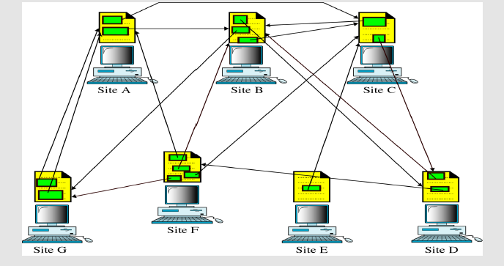
Distributed hypertext
Diagram shows how linked hypertext documents may reside

Slide 7
World Wide Web
The World Wide Web (abbreviated as WWW or W3 and commonly known as the Web) is a system of interlinked hypertext documents accessed via the Internet.
With a web browser, one can view web pages that may contain text, images, videos, and other multimedia and navigate between them via hyperlinks.
Using concepts from earlier hypertext systems, British engineer and computer scientist Sir Tim Berners-Lee, now Director of the W3C has invented WWW.

Slide 8
World Wide Web
The key feature of this was Tim Berners-Lee’s invention of the hypertext link, an embedded one-way pointer to another location
This location could be another point within the same document, another document, a different resource such as an image or sound file,
these could be on the local server, or some server anywhere in the world.
These documents are viewed with a browser such as Firefox, Opera, Microsoft Internet Explorer, and Google Chrome.

Slide 9
Core Features of the Web
URL+HTTP+HTML+Server-Side Soft + Client-Side soft (Browser)
Shortly after that initial proposal Berners-Lee developed the main (still the core) features of the web:
A URL to uniquely identify a resource on the WWW.
(Where?)
The HTTP protocol to describe how requests and responses operate. (How to communicate?)
A software program (later called web server software)
that can respond to HTTP requests. (How to reply?)
HTML to publish documents. (How to present?)
A program (later called a browser) to make HTTP requests from URLs and that can display the HTML it receives. (How to control?)

Slide 10
Evolution of Web
Web 1.0 – That era was all about read-only content and static HTML websites.
Web 2.0 – This is about user-generated content and the read-write web. People are consuming as well as contributing information through blogs or sites like Flickr, YouTube, Digg, etc. The line dividing a consumer and content publisher is increasingly getting blurred in the Web 2.0 era.
Web 3.0 – This was thought to be about semantic web (or the meaning of data), intelligent search and behavioral advertising among other things & most of all collective intelligence.

Slide 11
Web 3.0
Although Web 3.0 has not yet been given a formal definition, it does have several distinguishing characteristics:
Decentralization: Information might be stored simultaneously in numerous locations and become decentralized with Web 3.0 since it would be found based on its content rather than a single location.
Decentralization and open source software-based Web 3.0 will also be trustless (i.e., participants will be able to interact directly without going via a trusted intermediary) and permissionless (meaning that each individual can access without any governing body's permission).
Artificial intelligence (AI) and machine learning: With the help of the Semantic Web and natural language processing-based technologies, Web 3.0 will enable machines to comprehend information similarly to humans.
Connectivity and ubiquity: With Web 3.0, content and information are more accessible across applications and with a growing number of commonplace devices connected to the internet. The Internet of Things is one such example.

Slide 12
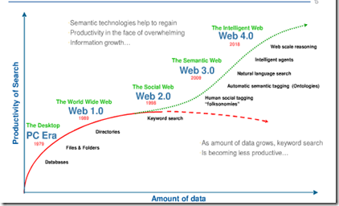
Evolution of the Web

Slide 13
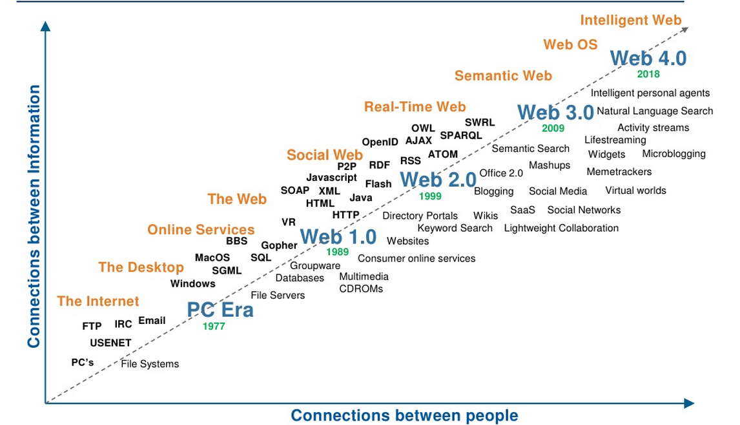
Evolution of the Web

Slide 14
Web Standards
The World Wide Web Consortium (W3C) is an international community that develops open standards to ensure the long-term growth of the Web.
Founded in 1994 by Sir Tim Berners-Lee (inventor of the Web)
W3C is the home of the Web and Semantic Web (http://www.w3.org)
400+ members (the usual suspects, SMEs, users,...) (http://www.w3.org/Consortium/Member/List)
Invited experts and volunteers

Slide 15
Design Principles
Web for Everyone
One of W3C's primary goals is to make these benefits available to all people, whatever their native language, culture, geographical location, or physical or mental ability.
Web on Everything
The number of different kinds of devices that can access the Web has grown immensely. Mobile phones, smart phones, personal digital assistants, interactive television systems, voice response systems, kiosks and even certain domestic appliances can all access the Web.

Slide 16
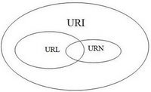
Web Terminologies
URN:
URN stands for Uniform Resource Name and it identifies a resource by name in a given namespace. A namespace refers a group of names or identifiers.
For example, in the International Standard Book Number (ISBN) system, ISBN 0-486-27557-4 identifies a specific edition of a book. The URN for that edition would be urn:isbn:0-486-27557-4.
However, it gives no information as to where to find a copy of that book.
URL:
URL stands for Uniform Resource Locator and it defines the network location of a specific resource. A resource, or a web resource refers to anything ranging from documents, files, images, web pages, etc that can be part of the web architecture.
https://helloworld.com/2014/02/22/url-vs-uri-vs-urn/
URI:
URI stands for Uniform Resource Identifier and it uniquely identifies a resource over the Web.
URNs and URLs both are different kinds of URIs

Slide 17
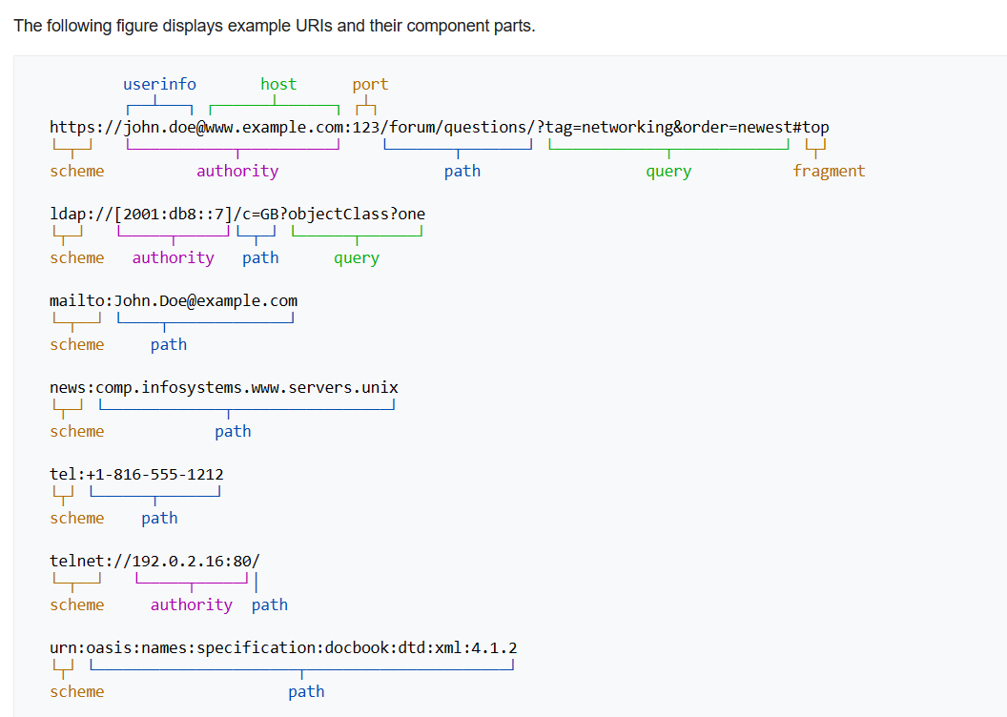
URI examples

Slide 18
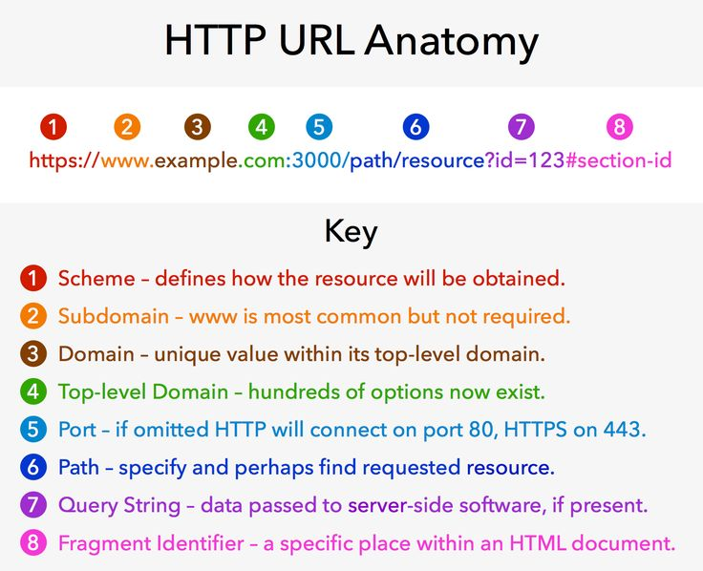

Slide 19
URL: schemes (e.g. http)
http: is the most common scheme; it means use the HTTP protocol
https: is similar to http: except that it uses SSL encryption
file: means read a file from the local disk
mailto: means open an email program composing a message
There are several other schemes, such as ftp:, but they aren't used much anymore.

Slide 20
URL Encoding
Any character in a URL other than A-Z, a-z, 0-9, or any of -_.~ must be represented as %xx, where xx is the hexadecimal value of the character:
http://www.stats.com/companyInfo?name=C%26H%20Sugar
-where %26 represents ‘&’ and %20 represents a white space

Slide 21
Query String
They are the way of passing information such as user form input from the client to the server. In URL's they are encoded as key-value pairs delimited by “&”
symbols and preceded by the “?” symbol.
Keys
?firstname=ferret&bckcolor=purple
Values
Delimiters
Full URI:
https://example.com/path/to/page?firstname=ferret&bckcolor=purple

Slide 22
HTTP Protocol
The Hypertext Transfer Protocol (HTTP) is an application layer protocol in the Internet protocol suite model for distributed, collaborative, hypermedia information systems.
HTTP is the foundation of data communication for the World Wide Web, where hypertext documents include hyperlinks to other resources that the user can easily access.
The HTTP protocol establishes a TCP connection on port 80 (by default).
The server waits for the request, and then responds with a response code, headers and an optional message (which can include files).

Slide 23
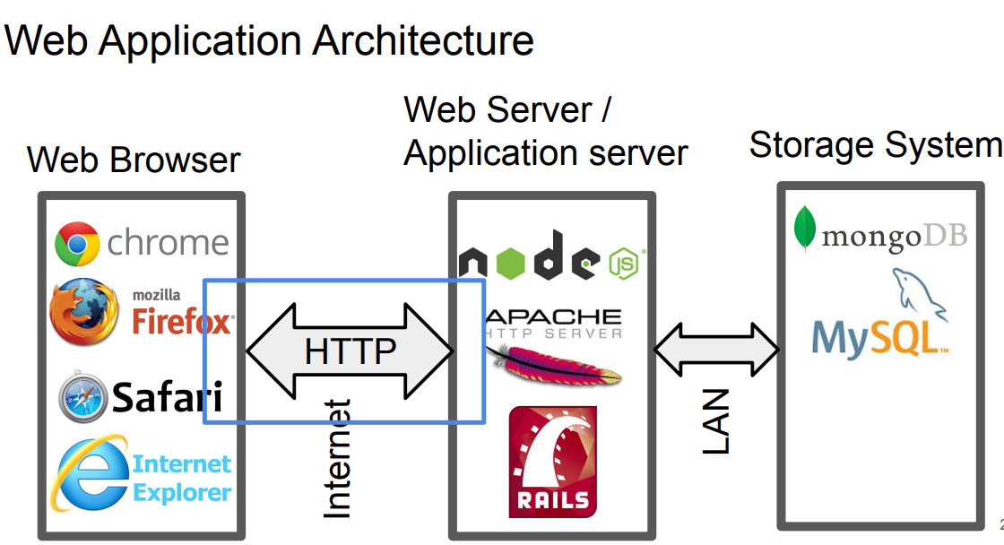
HTTP Request/Response usage

Slide 24
HTTP
HTTP is a transaction oriented client/server protocol.
HTTP uses TCP and creates a TCP connection for each transaction (e.g. download a page).
HTTP is a stateless protocol.
A stateless protocol is a communications protocol that treats each request as an independent transaction that is unrelated to any previous request.
Each transaction is treated separately so that the communication consists of independent pairs of requests and responses.
If a web server needs to store a client's state, it can store cookies in the client’s web browser (cookies are not part of http).

Slide 25
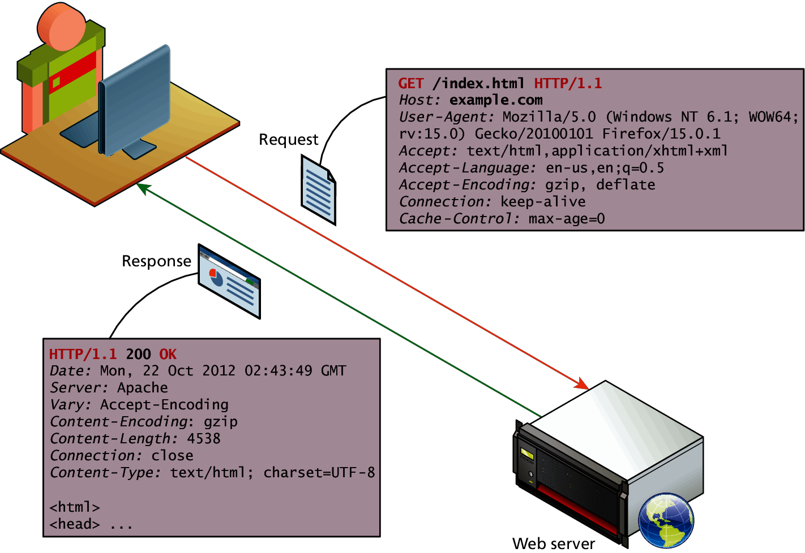
HTTP

Slide 26
Web Requests
While we as web users might be tempted to think of an entire page being returned in a single HTTP response, this is not in fact what happens.
In reality the experience of seeing a single web page is facilitated by the client's browser which requests the initial HTML page, then parses the returned HTML to find all the resources referenced from within it, like images, style sheets and scripts.
Only when all the files have been retrieved is the page
fully loaded for the user

Slide 27
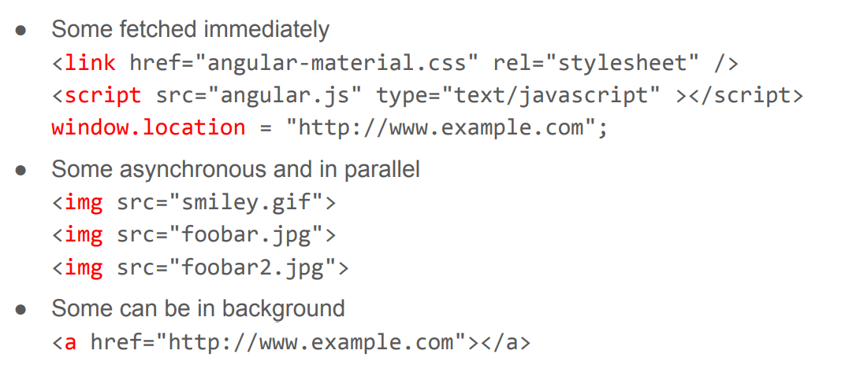
Browser spends its life fetching things using HTTP

Slide 28
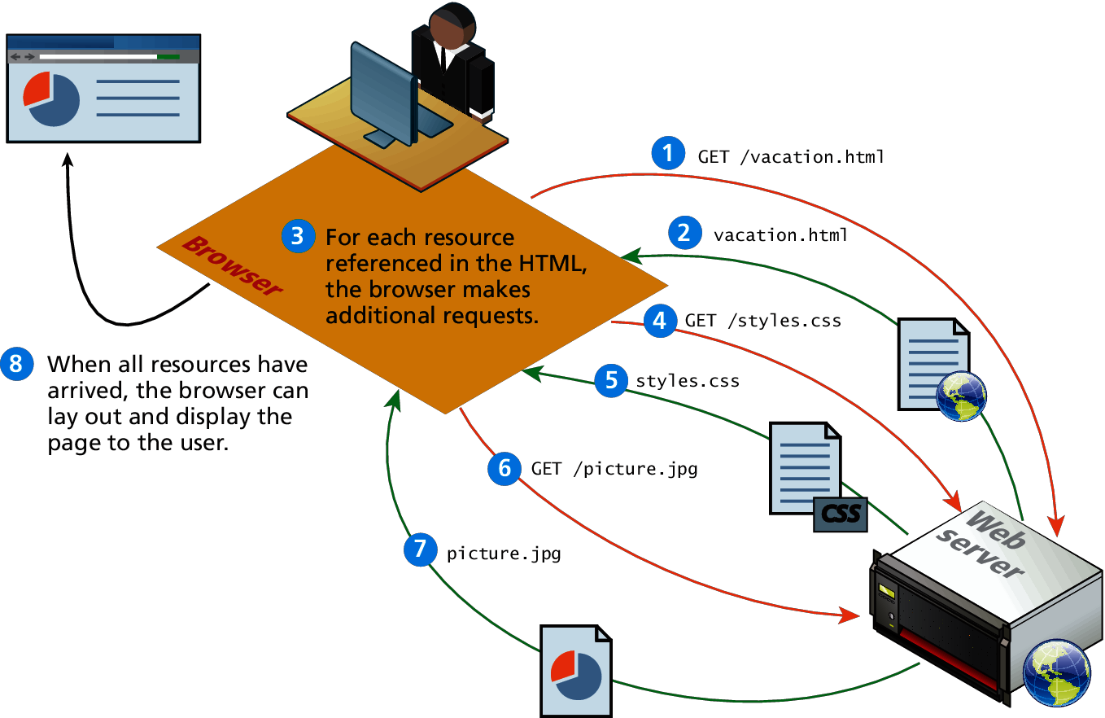
Browser parsing HTML and making subsequent requests

Slide 29
HTTP Request Methods
The HTTP protocol defines several different types of requests, each with a different intent and characteristics.
GET - Fetch a URL
HEAD - Fetch information about a URL
PUT - Store to an URL
POST - Send form data to a URL and get a response back
DELETE - Delete a URL
The most common requests are the GET and POST request, along with the HEAD request.
REST APIs used GET, PUT, POST, and DELETE

Slide 30
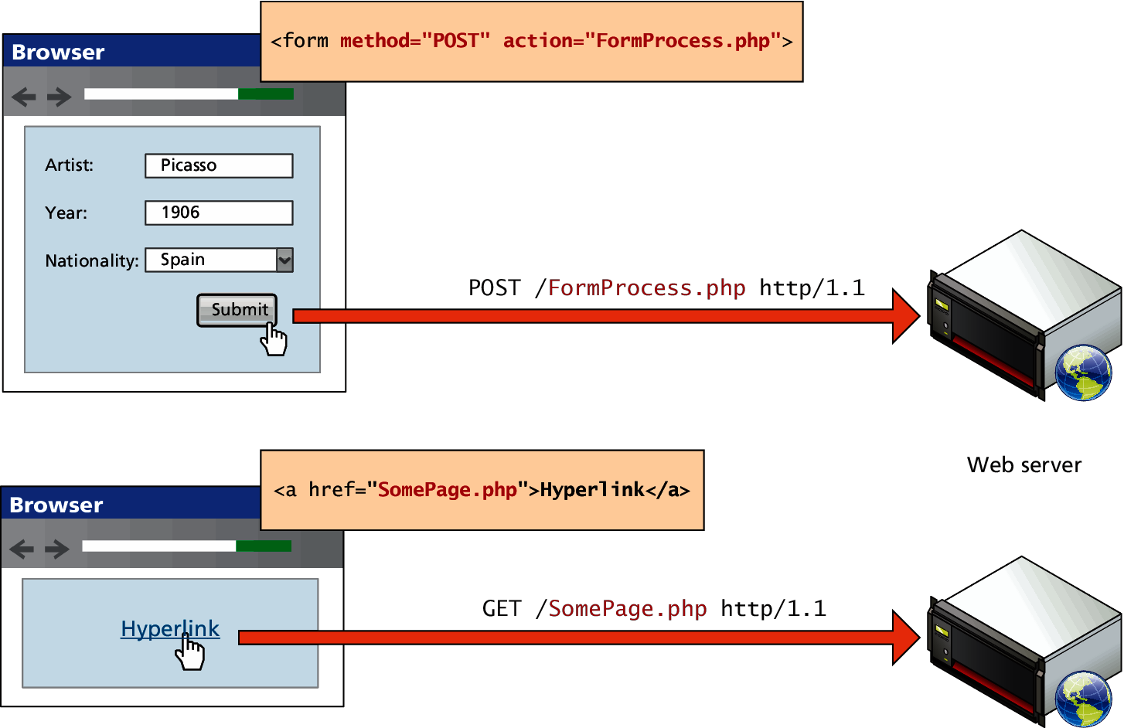
GET versus POST requests

Slide 31
Common HTTP Response Status Codes
200 OK Success
307 Temporary Redirect Redirection - Browser retries using Location header
404 Not Found Famous one
503 Service Unavailable Something crashed on the server
500 Internal Server Error Something is messed up on the server
501 Not Implemented Coming
400 Bad Request Use if web app sends bogus request
401 Unauthorized Use if user isn't logged in
403 Forbidden Use if even logging in wouldn't help
550 Permission denied Not allow to perform request

Slide 32
Browser caching control
HTTP Response Header: Cache-Control: max-age= <seconds>
Browser can reuse reply younger than the max-age
Cache-Control: max-age=120 - Age out in two minutes.
Frequently used on fetches of static content like images, templates, CSS, JavaScript.
Good: Reduce app startup latency and server load
Bad: Changes might not be picked up right away

Slide 33
Http Request/ Response Message
Request Message
GET /hello.htm HTTP/1.1
User-Agent: Mozilla/4.0 (compatible; MSIE5.01; Windows NT)
Host: www.tutorialspoint.com
Accept-Language: en-us
(blank line)
Response Message
HTTP/1.1 200 OK
Date: Mon, 27 Jul 2009 12:28:53 GMT
Server: Apache/2.2.14 (Win32)
Last-Modified: Wed, 22 Jul 2009 19:15:56 GMT
Content-Length: 88
Content-Type: text/html
Connection: Closed
(blank line)
<html>
<body>
<h1>Hello, World!</h1>
</body>
</html>

Slide 34
Request/ Response Example
HTTP request to fetch t.html page that does not exist on the web server running on tutorialspoint.com.
Request Message
GET /t.html HTTP/1.1
User-Agent: Mozilla/4.0 (compatible; MSIE5.01; Windows NT)
Host: www.tutorialspoint.com
Accept-Language: en-us
Accept-Encoding: gzip, deflate
Response Message
HTTP/1.1 404 Not Found
Date: Sun, 18 Oct 2012 10:36:20 GMT
Server: Apache/2.2.14 (Win32)
Content-Length: 230
Content-Type: text/html;
Connection: Closed
<html>
<head>
<title>404 Not Found</title>
</head>
<body>
<h1>Not Found</h1>
<p>The requested URL /t.html was not found on this server.</p>
</body> </html>

Slide 35
Web Stack
Regardless of the physical characteristics of the server, one must choose an application stack to run a website.
This stack will include an operating system, web server software, a database and a scripting language to process dynamic requests.

Slide 36
Web Stack
LAMP Linux/Apache/MySQL/PHP
Variations: (WAMP, MAMP, XAMP)
PHP is interchangeable with the languages Python and Perl.
It’s flexible, customizable, easy to develop, easy to deploy, secure, and comes with a huge support community since it’s open-source. Also, SQL databases are great for organizing massive amounts of highly structured data.
WISA Windows/IIS/SQL Server/ASP.net
MEAN, MERN
MEAN benefits: Supports the MVC pattern, uses NoSQL’s native JSON for data transfer, offers access to Node.js’s JavaScript module library, and is open-source.
Also, it’s mobile-friendly, thanks to AngularJS’s flexibility, and can easily incorporate JS testing frameworks.

Slide 37
References
https://flatworldbusiness.wordpress.com/flat-education/previously/web-1-0-vs-web-2-0-vs-web-3-0-a-bird-eye-on-the-definition/
https://www.business2community.com/tech-gadgets/eras-of-the-web-web-0-0-through-web-5-0-02239654
https://www.researchgate.net/publication/321366810_Concept_and_Dimensions_of_Web_40
https://www.w3.org/
https://www.w3.org/WAI/fundamentals/accessibility-intro/
What Is Web 3.0? Everything You Need to Know About Web 3.0 | Simplilearn
CSC142 Lecture notes by Mendel Rosenblum
What Are the Different Parts of Url Explain With Example (joeydesnhwall.blogspot.com)

